Slide 1
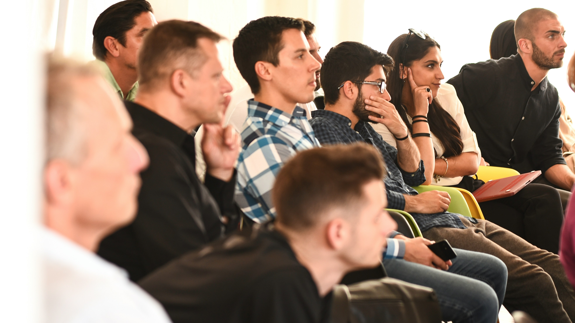
IP for Pitch
Competition Founders
Protect • Profit • Pitch with confidence
Stewart Myers • Registered Patent Attorney
Cognivito • Modern Patent Protection

Slide 2
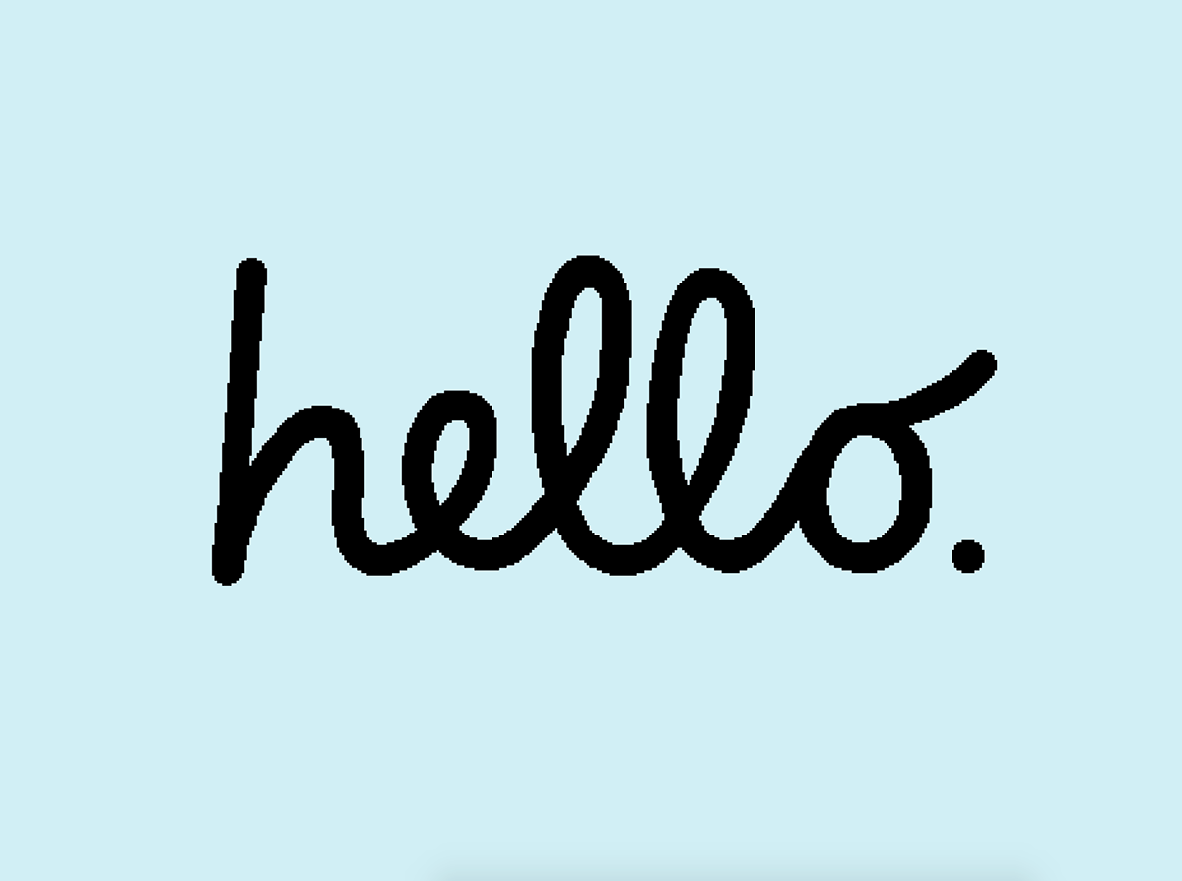
Notes:
The iconic "hello" script, which appeared on the first Macintosh in 1984, was created by graphic designer Susan Kare. She was commissioned by Apple to design user-friendly icons, typefaces, and interface elements for the original Macintosh team, including the famous cursive "hello" text.
Made bit by bit

Slide 3
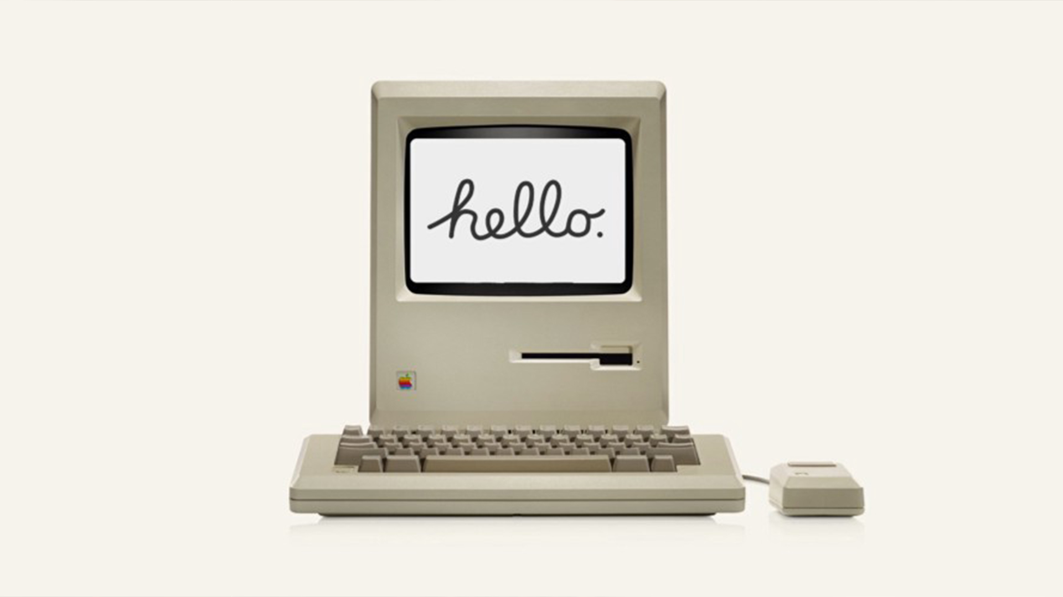
Notes:
The iconic "hello" script, which appeared on the first Macintosh in 1984, was created by graphic designer Susan Kare. She was commissioned by Apple to design user-friendly icons, typefaces, and interface elements for the original Macintosh team, including the famous cursive "hello" text.

Slide 4
Today (60 minutes)
Simple, practical, and pitch-competition friendly
1) The 4 major IP areas (copyrights, trademarks, trade secrets, patents)
2) What each one is (in plain English)
3) What each one protects (and where they overlap)
4) How founders profit from each kind of IP
5) How to obtain protection (practical next steps)
We’ll cover:
cognivito.com

Slide 5



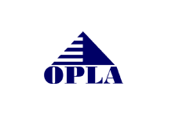
Quick note
This is education, not legal advice
General information only — talk to counsel about your facts
Laws vary by country and change over time
Don’t disclose confidential details to the public during this session
Your guide today:
Stewart Myers
Registered Patent Attorney
Focus: startup-friendly IP strategy
(so you can protect value *and* ship product)
cognivito.com
Notes:
Bio time

Slide 6
What is “intellectual property”?
Think: legal tools that turn your work into an asset
IP is the set of laws that let you control how others use certain outputs of creativity and innovation.
Your
innovation
IP
protection
$$
Hot take: IP isn’t “paperwork.” It’s a business lever. (Sometimes it’s also paperwork.)
cognivito.com
Notes:
Underwear gnomes: Step 2! Added

Slide 7
Why investors care about IP
Because “value” is increasingly intangible
Ocean Tomo reports intangible assets now represent >90% of S&P 500 market value (2020).
What founders should do with this:
Identify what’s defensible (not just what’s cool)
Protect it in the right bucket(s)
Use IP to de-risk your pitch and your go-to-market
cognivito.com
Notes:
a firm specializing in intellectual property (IP) and intangible asset services, including expert testimony, valuation, strategy, and risk management.

Slide 8
The 4 major areas of IP
Most startups use *multiple* at the same time
©
Copyrights
™
Trademarks
Protect original expression: code, text, images, music, video, UI art.
Protect brand identifiers: names, logos, slogans (source of goods/services).
🔒
Trade Secrets
⚙
Patents
Protect confidential business/technical info you actively keep secret.
Protect new, useful, non-obvious inventions (functional or ornamental).
Rule of thumb: Protect what makes customers pay (and competitors sweat).
cognivito.com
Notes:
Can be overlap between these areas, don’t waste money on what’s not important. Especially at startup stage

Slide 9

Where they overlap
One product can have multiple IP layers
Trademark: app name + icon
Copyright: code + UI art
Trade secret: algorithms, pricing, playbooks
Patent: novel features / methods
You don’t pick ONE forever. You build a stack (based on what’s valuable and copyable).
cognivito.com
Notes:
[Sources] - https://www.uspto.gov/sites/default/files/documents/TM-Registration-Toolkit.pdf (IP types overview) - https://www.copyright.gov/help/faq/faq-general.html (copyright basics) - https://www.law.cornell.edu/uscode/text/18/1839 (trade secret definition, DTSA) - https://www.uspto.gov/patents/basics/essentials (patent basics) [/Sources]

Slide 10
Myth-busting (startup edition)
Save yourself pain later
“I emailed myself proof”
“NDA fixes everything”
“Patent pending = protected”
Copyright exists automatically, but enforcement often requires registration. Emailing yourself is not a strategy.
NDAs are useful, but they do not create patents, trademarks, or copyrights — and they can be hard to enforce.
Patent pending is a status, not a guarantee. Protection depends on what ultimately issues (if anything).
cognivito.com
Notes:
May allow for pre-issuance royalties if claims relatively similar, and infringer had actual notice of the published application
Puts competitors on notice that a patent application has been filed • Creates uncertainty that can deter copying • Signals seriousness and professionalism • Strengthens negotiating leverage with investors and partners • Supports potential pre-issuance royalty claims (if statutory requirements are met) • Helps establish awareness that may support later willfulness arguments • Enhances perceived value of the invention • Costs nothing beyond filing the application • Protects priority date while product is being developed or marketed

Slide 11
Copyrights
©
Protecting creative expression

Slide 12
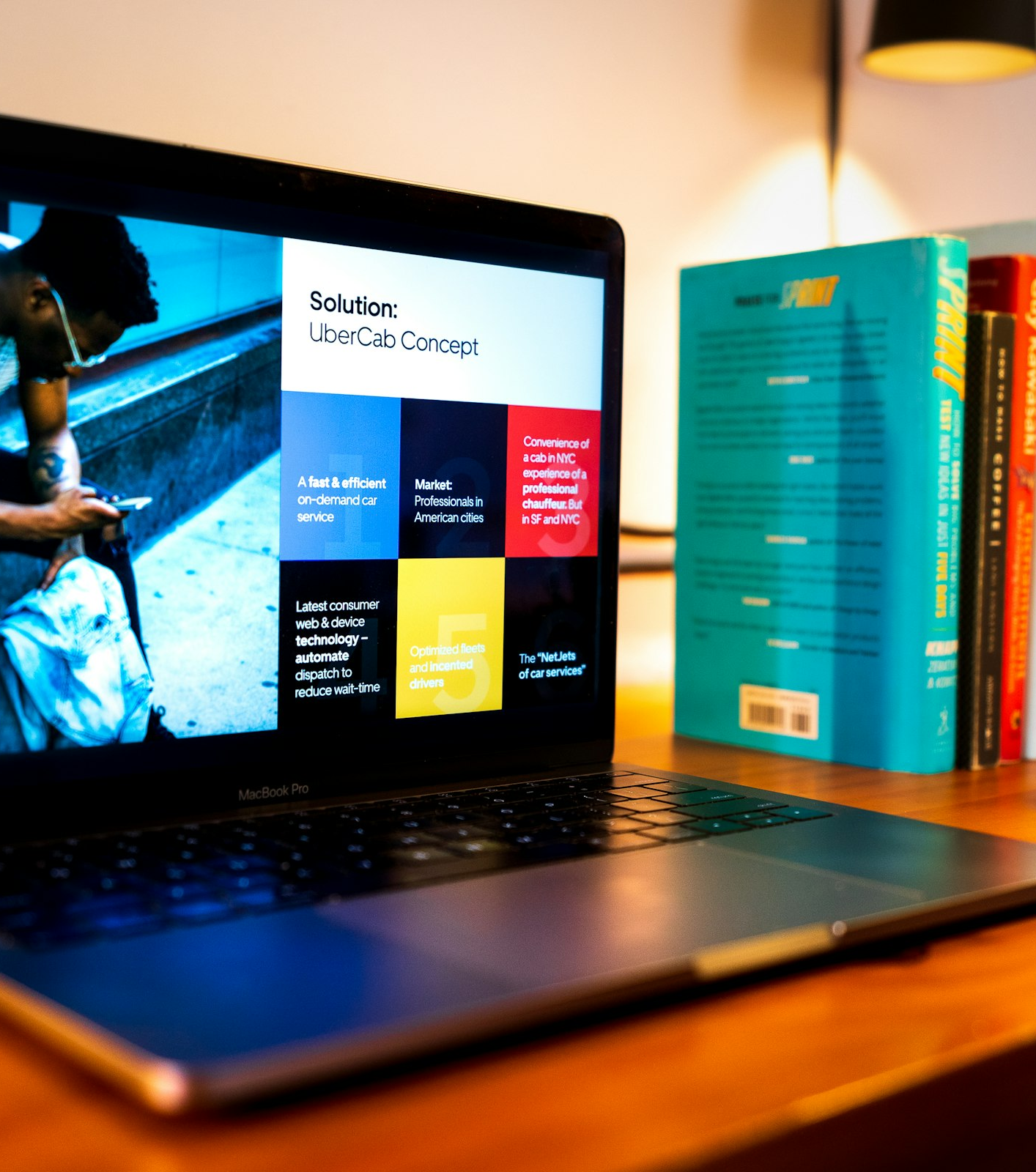
Copyrights: what are they?
The default protection for original expression
Copyright protects original works of authorship fixed in a tangible medium.
Software code
Website copy + graphics
Product photos + videos
Slide decks and marketing materials
UX/UI artwork (not the underlying idea)
Startup examples:
cognivito.com
Notes:
Parody • Commentary • Criticism • News reporting • Scholarship • Transformative uses

Slide 13
Copyright: what it protects (and doesn’t)
Expression vs. ideas
Usually protected
Usually NOT protected
Source code (your specific code)
Artwork / graphics / photos
Text (copy, documentation)
Audio/video content
UI layout and design elements (as art)
Ideas, concepts, or “the app idea”
Facts and data (by themselves)
Functional methods / processes
Short phrases or names (use trademark)
Someone else’s work you copied
cognivito.com
Notes:
Work TypeDuration
Created 1978 or laterLife + 70
Joint work70 years after last author dies
Work made for hire (post-1978)95 years from publication or 120 from creation
Published before 197895 years from publication
Created pre-1978 but unpublished Life + 70 (with transitional minimums)
Anything published in the United States in 1929 or earlier is now in the public domain.
Public domain works = 1929. Every Jan 1st, another year ticks off Author writes a manuscript in 1929 at age 25
Lives until 1985
Copyright lasts until 1985 + 70 = 2055
[Sources] - https://www.copyright.gov/help/faq/faq-general.html [/Sources]

Slide 14
How founders profit from copyrights
“Content” can be a moat
Common profit levers:
Licensing (SaaS templates, stock assets, APIs docs, training materials)
Partnerships (white-label content, co-marketing assets)
Monetizing media (courses, newsletters, videos)
Enforcement (takedowns of copied marketing pages, images, videos)
Valuation story: “we own the codebase + content library”
cognivito.com
Notes:
In addition to the more widespread author, artist, painter owning the copyright model

Slide 15
How to obtain copyright protection
Most of it is automatic — registration is the upgrade
1) It’s automatic when you create + fix the work (save drafts + dates).
2) Register if you need stronger enforcement (public record; required before suing in U.S. federal court for U.S. works).
3) Use contracts: make sure you actually OWN what contractors create (assignments / work-for-hire).
4) Online copying: DMCA takedown process can help in many contexts.
Good founder habit: put “IP ownership” in every contractor agreement.
If you don’t own it, you can’t protect it (or sell it).
cognivito.com
Notes:
[Sources] - https://www.copyright.gov/help/faq/faq-general.html - https://www.copyright.gov/engage/docs/registration.pdf (registration prerequisite) [/Sources]

Slide 16
Trademarks
™
Protecting brand identifiers

Slide 17
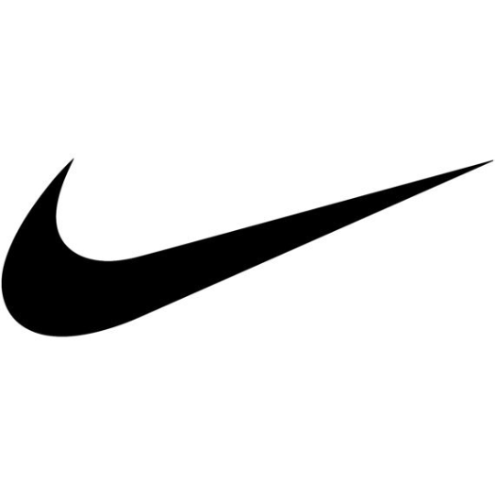
Trademarks: what are they?
A trademark identifies the source of goods/services
Trademarks protect brand identifiers that tell customers “this came from you.”
Examples:
A
Company + product names
Logos
Taglines
Sometimes: colors, sounds, packaging (trade dress)
In your pitch: be clear on the brand you’re building and whether you’ve cleared/registered it.
cognivito.com
Notes:
“Independent brand valuation firms peg the NIKE brand at roughly $29B–$34B, and the Swoosh is a primary brand identifier within that asset, so its implied value is in the tens of billions.”

Slide 18
Trademarks: quick pitfalls
Brand names are cheap to pick — expensive to change
Do this
Avoid this
Pick a distinctive name (made-up > suggestive > descriptive)
Do a clearance search early
Secure domain + social handles (if possible)
Use ™ while building rights
Register when the name matters
Generic/descriptive names you can’t own
Assuming LLC name = trademark
Assuming domain name = trademark
Copying “close enough” names/logos
Spending on brand before searching
cognivito.com
Notes:
The Exxon story [Sources] - https://www.uspto.gov/trademarks/basics/what-trademark [/Sources]

Slide 19
How founders profit from trademarks
Trust → conversion → pricing power
Trademarks help you:
Prevent look-alike competitors from stealing customers
Build loyalty and increase conversion rates
Expand into new product lines (brand extension)
License/franchise (brand becomes a revenue engine)
Reduce diligence friction: investors like clean brand ownership
Pitch-friendly phrasing: “We’ve cleared the brand and filed for federal registration.”
cognivito.com
Notes:
[Sources] - https://www.uspto.gov/trademarks/basics/why-register-your-trademark [/Sources]

Slide 20
How to obtain trademark protection
Use creates rights; registration strengthens them
1. Search
2. File
3. Exam
4. Publish
5. Register
Clearance search
(trademarks + common law)
USPTO application
(goods/services classes)
Office actions?
Respond if needed
Opposition period
(others can object)
Use ® after registration
Maintain renewals
Founders shortcut: do the search BEFORE you print 5,000 boxes.
Registration benefits include nationwide presumptions and federal enforcement.
cognivito.com
Notes:
[Sources] - https://www.uspto.gov/trademarks/basics/why-register-your-trademark - https://www.uspto.gov/trademarks/basics/what-trademark [/Sources]

Slide 21
Trade Secrets
🔒
Protection by secrecy

Slide 22
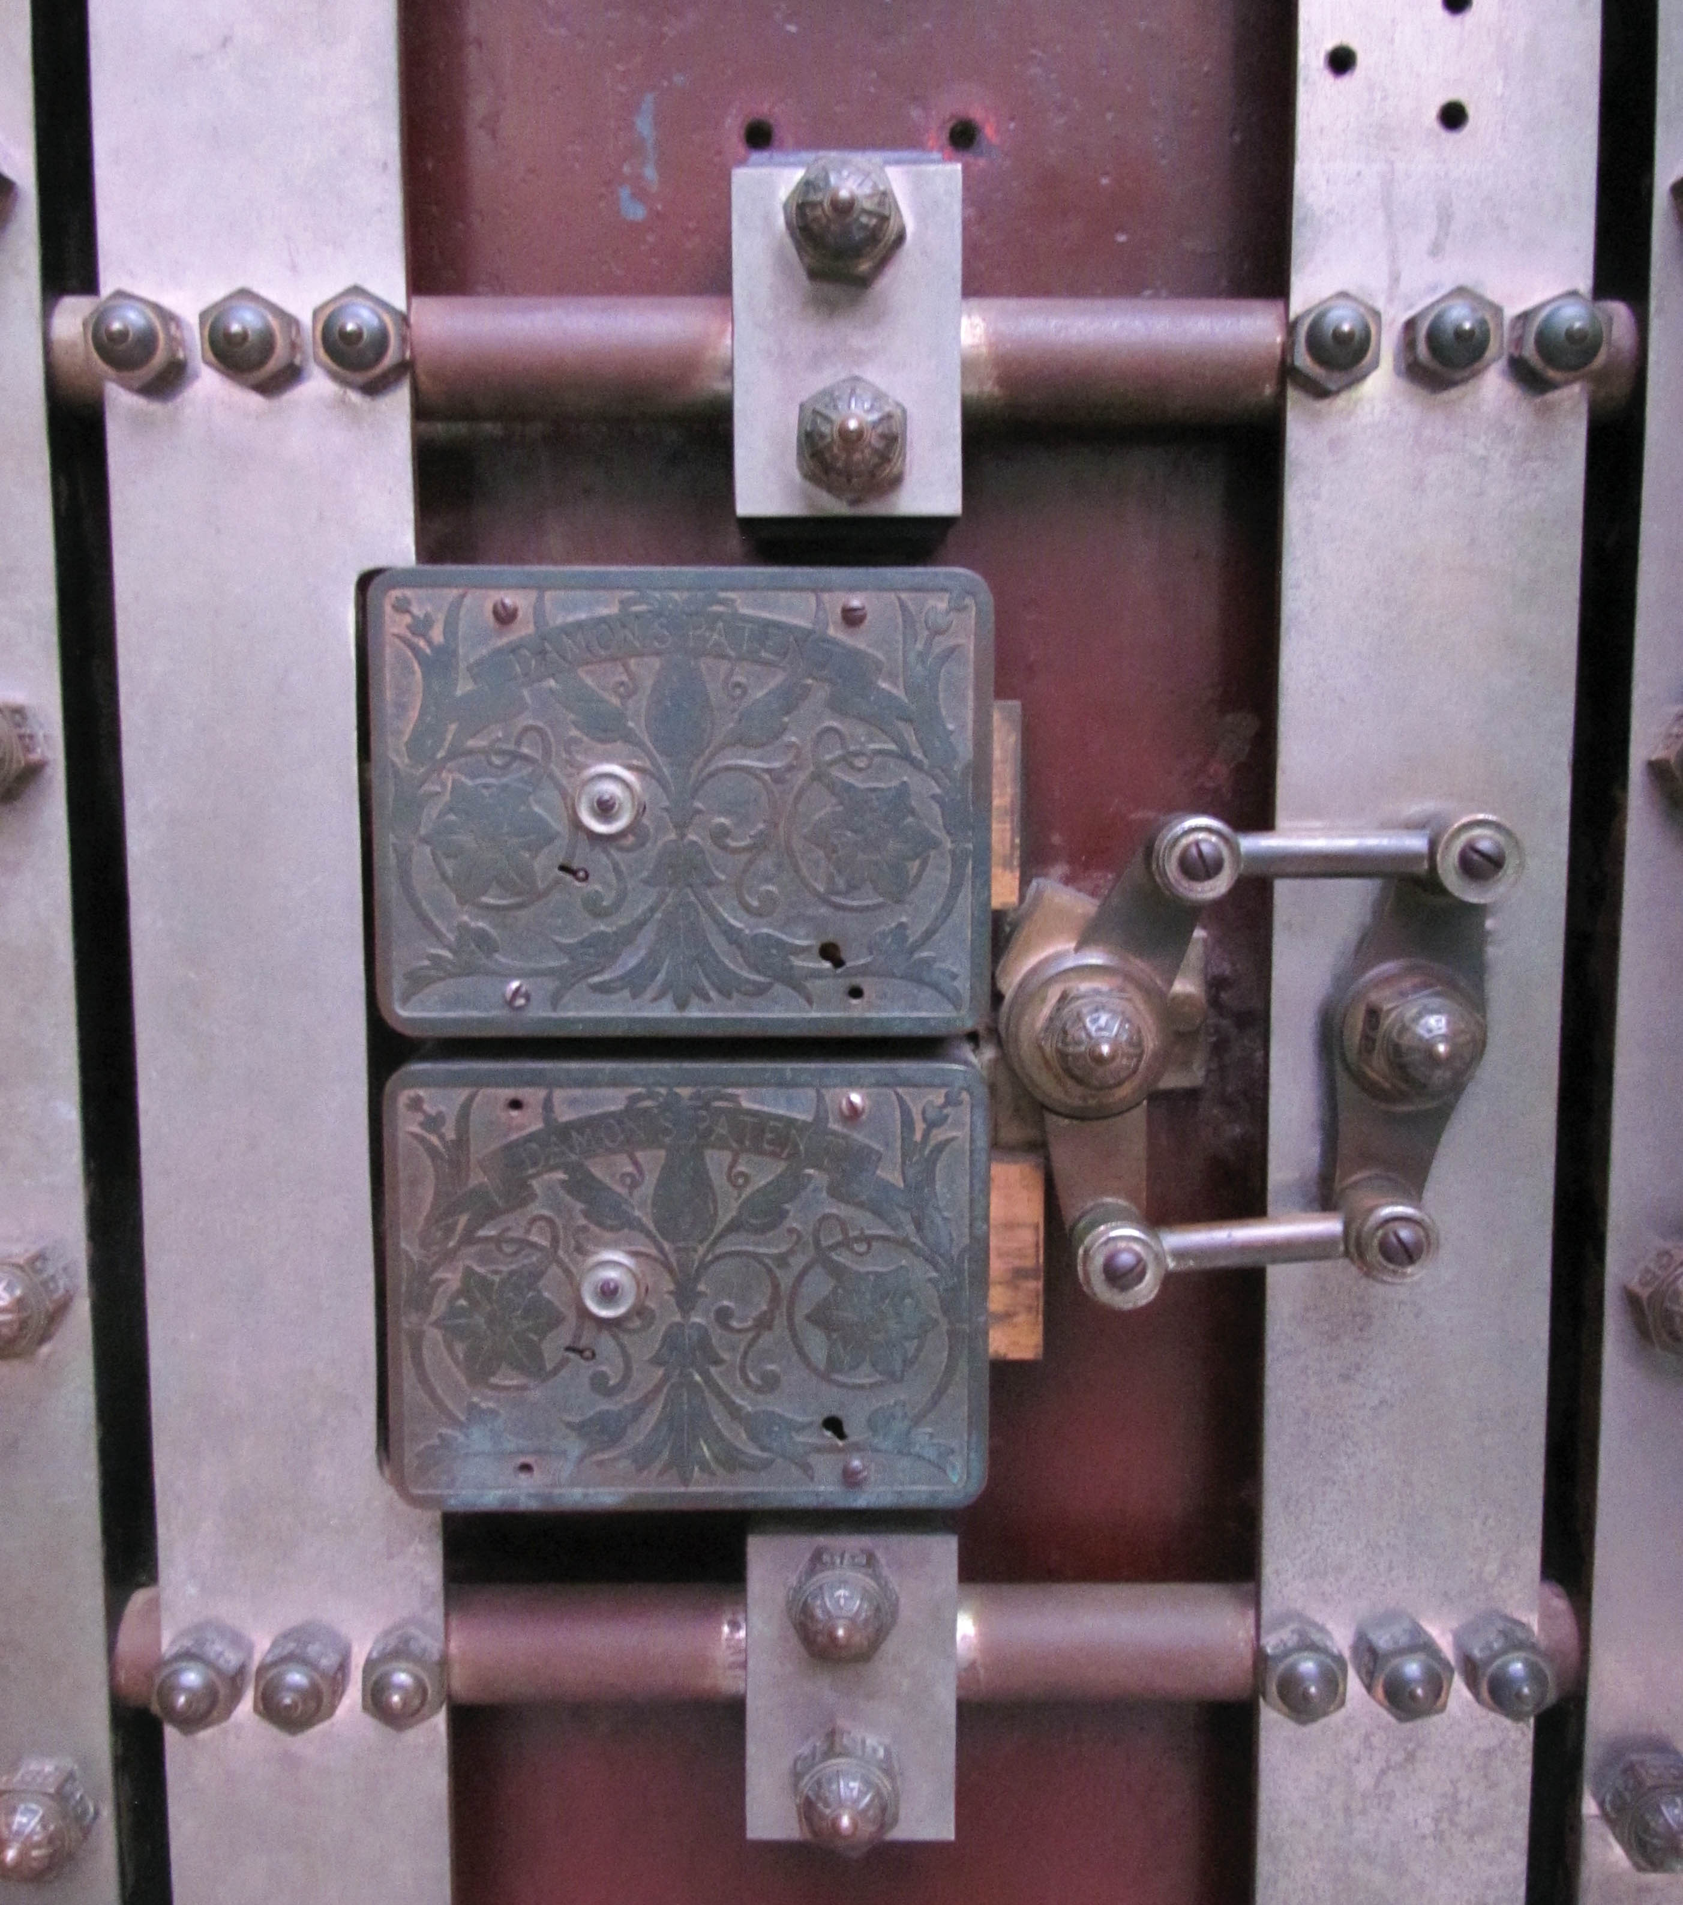
Trade secrets: what are they?
If it’s public, it’s not a secret
A trade secret is valuable information that you take reasonable measures to keep secret.
Not generally known
Economic value from being secret
Reasonable secrecy measures (access control, NDAs, etc.)
Core requirements:
Trade secret protection can last forever… until you lose secrecy.
cognivito.com
Notes:
[Sources] - https://www.law.cornell.edu/uscode/text/18/1839 (definition) - https://commons.wikimedia.org/wiki/File:Vault_Door,_Federal_Hall.jpg (photo, CC BY-SA 4.0) [/Sources]

Slide 23
Trade secrets: what they can protect
Business + technical know-how
Good trade secret candidates
Bad trade secret candidates
Pricing models, margins, supplier terms
Algorithms / ML features (if hard to reverse engineer)
Customer lists + sales playbooks
Manufacturing methods
Roadmaps and internal analytics
Anything you must publicly disclose
Anything competitors can easily reverse engineer
Things shared widely without controls
“Everyone knows this” methods
Information leaked in a pitch deck or demo
cognivito.com
Notes:
[Sources] - https://www.uspto.gov/sites/default/files/documents/tradesecretsiptoolkit.pdf [/Sources]

Slide 24
Trade secret vs patent
A fork in the road
Ask 3 questions:
1) Can competitors reverse engineer it quickly?
No → Secret is feasible
Yes → Patent may be better
2) Do you need to disclose it to sell/use it?
No → Secret is feasible
Yes → Patent (or contracts)
3) Will it still be valuable in 2–5 years?
Maybe/yes
If short-lived, secret may win
Key tradeoff: patents require disclosure; trade secrets require discipline.
cognivito.com
Notes:
[Sources] - https://www.uspto.gov/sites/default/files/documents/tradesecretsiptoolkit.pdf - https://www.uspto.gov/patents/basics/essentials [/Sources]

Slide 25
How founders profit from trade secrets
Fast, flexible protection
No registration costs; protection can be immediate
Great for processes and know-how that never shows up in the product
Works well with contracts (NDAs, confidentiality clauses)
Useful even if you later patent other parts
Can increase acquisition value (documented secret sauce)
But: one accidental public disclosure can destroy the asset.
cognivito.com
Notes:
[Sources] - https://www.uspto.gov/sites/default/files/documents/tradesecretsiptoolkit.pdf [/Sources]

Slide 26
How to obtain trade secret protection
It’s a practice, not a filing
Trade secret “checklist”:
Identify the secret (write it down; label it)
Limit access (need-to-know; role-based permissions)
Use NDAs/confidentiality clauses with employees + contractors
Secure storage (passwords, encryption, access logs)
Exit hygiene (offboarding checklists, device returns)
Don’t overshare in pitches, demos, or public repos
cognivito.com
Notes:
[Sources] - https://www.law.cornell.edu/uscode/text/18/1839 - https://www.uspto.gov/sites/default/files/documents/tradesecretsiptoolkit.pdf [/Sources]

Slide 27
Patents
⚙
Protecting inventions

Slide 28
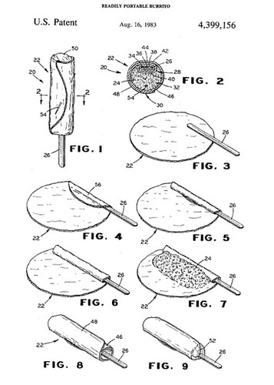
Patents: what are they?
A patent is the right to exclude (not a right to practice)
A U.S. patent gives the right to exclude others from making, using, selling, offering for sale, or importing the claimed invention.
Types you’ll hear about:
Utility patents: functional inventions
Design patents: ornamental appearance
Plant patents: certain asexually reproduced plants
Big idea: patents trade disclosure for exclusivity.
You publish the how → get a time-limited right to exclude.
cognivito.com
Notes:
Readily portable burrito
Utility patent: 20 years from earliest non-provisional filing date • Design patent (filed on or after May 13, 2015): 15 years from issuance • Design patent (filed before May 13, 2015): 14 years from issuance

Slide 29
Patents: what they protect (and what they don’t)
Functional claims vs. ideas
Patents can protect
Patents don’t protect
A new device or system
A method/process (including software methods)
A composition/material
A novel ornamental design (design patent)
Improvements to existing tech
Abstract ideas (without a real technical implementation)
“I thought of it first” without filing
Things already publicly disclosed/known (prior art)
Pure business plans
Trade secrets you refuse to disclose
cognivito.com
Notes:
[Sources] - https://www.uspto.gov/patents/basics/essentials [/Sources]

Slide 30
How founders profit from patents
More than “suing competitors”
Build leverage for partnerships + licensing
Create defensibility for fundraising (“we own the tech”)
Deter copycats (especially in hardware/consumer products)
Support a premium price and safer market entry
Provide assets for acquisition value and negotiation
Cross-license (avoid being blocked by others)
Defensive use: reduce risk of being shut down
cognivito.com
Notes:
Suggested timing: ~5 min

Slide 31
How to obtain a patent
A practical (not scary) overview
1) Capture
2) Search
3) File
4) Examine
5) Issue
Write it down
(what, how, variants)
Prior art search
(patentability)
Provisional or
non-provisional
USPTO review
& office actions
Pay fees
& maintain
Founders tip: you do NOT need a prototype to file — you need a complete description.
What kills patents: public disclosure before filing (pitch decks, demos, GitHub, sales).
cognivito.com
Notes:
[Sources] - https://www.uspto.gov/patents/basics/apply - https://www.uspto.gov/patents/basics/essentials [/Sources]

Slide 32
Provisional vs non-provisional
Two common filing paths
Provisional (PPA)
Non-provisional
Lower-cost first filing
Establishes an early effective filing date
Lets you say “Patent Pending”
Expires in 12 months (must follow with non-provisional)
Must fully describe the invention to be useful
The “real” application examined by the USPTO
Includes claims (define your legal protection)
Starts the path to a granted patent
More formal requirements
Strategy matters: claims + scope + support
cognivito.com
Notes:
Suggested timing: ~6 min [Sources] - https://www.uspto.gov/patents/basics/apply/provisional-application - https://www.uspto.gov/sites/default/files/patents/resources/types/provisional_appRevised.pdf [/Sources]

Slide 33
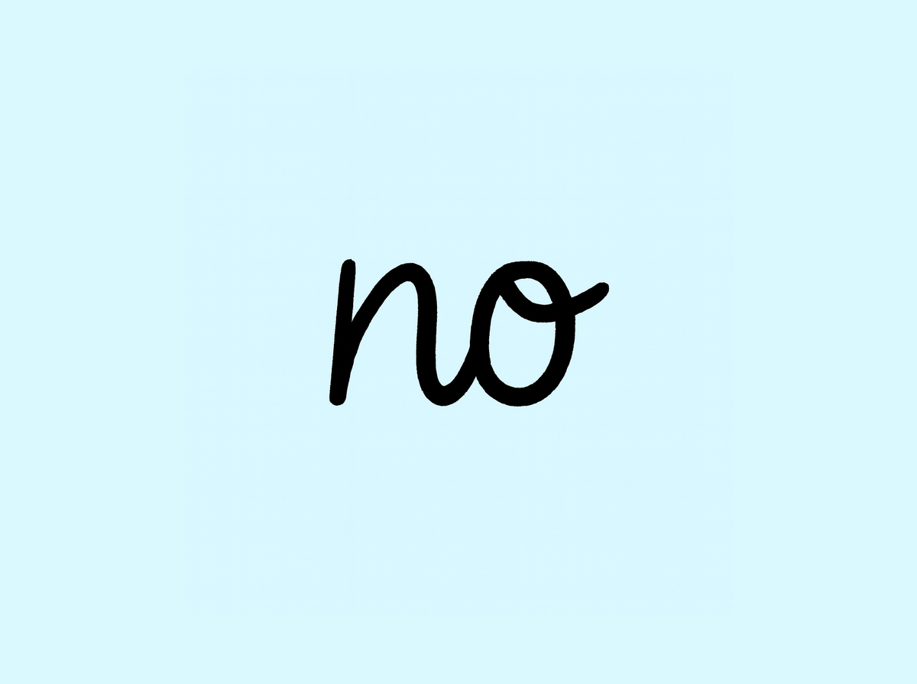
“Patent Pending”
What it means (and what it doesn’t)
Patent pending usually means a patent application has been filed.
It does NOT mean:
You already have a patent
You will definitely get a patent
You can sue someone today (usually)
You can safely disclose everything publicly
Use it as: a signal + a timestamp.
Then keep building and keep your filings strong.
cognivito.com
Notes:
[Sources] - https://www.uspto.gov/patents/basics/apply (patent pending referenced) - https://www.uspto.gov/sites/default/files/patents/resources/types/provisional_appRevised.pdf [/Sources]

Slide 34
Pitch competition IP checklist
What to say (and what to avoid saying)
Pitch-safe (usually)
Risky (be careful)
“We filed a provisional application on X date.”
“We own our code + brand assets.”
“We’re protecting our brand with trademark filings.”
“Key know-how is held as trade secrets with NDAs.”
High-level benefits (no secret sauce)
Detailed how-it-works diagrams
Exact formulas/parameters
Posting confidential slides publicly
Overclaiming (“patented” when not)
Sharing trade secrets without NDAs
cognivito.com
Notes:
Suggested timing: ~4 min

Slide 35
Founder-friendly action plan
Small steps that create real defensibility
Next 7 days
Next 30 days
Next 6 months
List your IP assets (use the IP map)
Check ownership (contracts, repos, domains)
Stop accidental disclosure of secrets
Do quick trademark clearance
File key trademarks
Decide patent vs secret on core innovations
Capture invention disclosures (write-ups + drawings)
Register critical copyright works
Build a filing cadence (patents, TM)
Operationalize trade secret measures
License/partner with IP in mind
Track renewals + assignments
cognivito.com

Slide 36
Q&A
Ask anything — business, strategy, pitch phrasing.
Stewart Myers
Stewart@cognivito.com
www.cognivito.com
541-740-7552
Notes:
Suggested timing: 5–10 min

